Slide 1
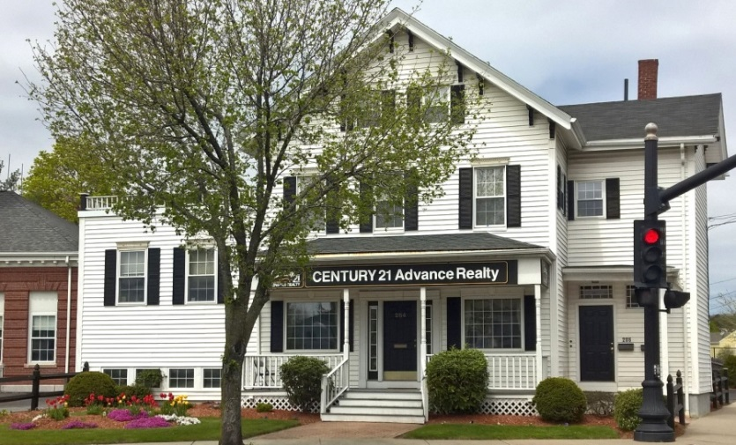
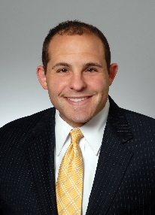
Introducing Steven Ultrino & CENTURY 21 Advance Realty
Steven Ultrino
CENTURY 21 Advance Realty
284 Salem St., Medford, MA 02155
Office: 781.395.2121
Cell: 617.733.7552
steveultrino@c21advance.com

Slide 2
The Goal of My Visit
Understand your goals, objectives and expectations…it is all
about you!
Understand your home and its valuable features and benefits.
Discuss the benefits of listing your home with a professional at CENTURY 21 Advance Realty.
Discuss our local market presence and my professional representation services.
Discuss current market conditions and market data to establish the market value of your home.
Discuss your pricing thoughts and pricing strategies.
Select the listing price for your home.
Assure your confidence in our service.

Slide 3
Working Together to Achieve Your Goals
Your goals, dreams, expectations and objectives are at the center of our selling process. In order to set the foundation for a successful transaction for your home, we can discuss the following topics:
Why you are selling your home?
Tell me about the time frame for your move?
What features do you especially like about your home?
Are there any challenges that you anticipate that we might have in selling your home?
Are there specific services that you want from me?
CENTURY 21 Advance Realty has successfully represented buyers and sellers in your neighborhood. Our knowledge, expertise, and total commitment to your goals drive a selling process that runs smoothly and achieves success.

Slide 4
A Global Powerhouse With The Agility And Commitment Of A Local Owner
Our REALTORS® and staff work in a positive supportive environment. Highly educated, energetic and career oriented, our sales associates have many years of experience. Newer agents are always paired with experienced agents (15 or more years of experience) so that clients always are served by well seasoned staff
We keep up to date on the latest market conditions, training and technology
We have been a leader in residential sales in our market area since 1981 and we have helped 1000’s of people buy or sell homes in Massachusetts.
We are ranked # 1 in our market area
We have earned the Century 21® Pinnacle Award for Quality Service and have earned Centurion® and Ambassador® awards for quality service and production
We have 28 fully-trained, full time agents and 6 administrative staff members whose only job is to help you. We believe in giving back to the communities we serve—we are members of many local charitable and service organizations.
We believe in SERVICE to our client and oftentimes go beyond what you might expect from a Realtor firm.

Slide 5
CENTURY 21 ADVANCE REALTY….
An Award Winning Office!
2017 – CENTURION® Award Winning Office
The CENTURION® Award is given to those offices in the Century 21 system for Top Production
2017 – Pinnacle Award Winning Office
The Pinnacle Award is given to those offices that finish the year with over 95% satisfaction among clients as surveyed by an independent survey company – we finished with a 98% satisfaction rate.
2017 – President’s Award
This Award is given to those offices who win the CENTURION® and Pinnacle Award – a very small percentage of offices

Slide 6
My Professional Experience
My Philosophy
“I have spent my entire career focusing on the needs of people. I have always been of the belief that honesty, professionalism and integrity lay the foundation of customer satisfaction. By building a relationship with you, we will accomplish all of your needs. It will be my pleasure making your real estate experience a long-lasting satisfaction.”
My Credentials
Licensed Real Estate Salesperson
Doctor of Education
Master of Science in Adult and Organization Learning
Bachelor of Arts in United States History and Secondary Education
Life Time Membership Award with the Massachusetts Association of School Committees
My Background
Senior Principal, Cornerstone Fundraising, LLC
Director of Operations and Finance, St. Mary’s Parish Winchester
Malden Kiwanis Club
Monsignor Neagle Housing Board, Treasurer
Past Malden City Councilor
Past Malden School Committee Member
Past Chairman of the Board and Chief Volunteer Officer, Malden YMCA
Steve Ultrino
Office: 781-395-2121 Cell: 617-733-7552
steveultrino@c21advance.com

Slide 7
Testimonials
Steve was absolutely amazing to work with. We had a pretty chaotic situation on our hands and Steve guided us through the storm and completely made the whole process easier for us. He was a pleasure to work with from day one and he really held our hands throughout the entire process and has even followed up multiple times since the close.
Brian, Chelmsford
I knew Mr. Ultrino’s reputation and I could not have been happier with the result! He made it relatively stress less from beginning to end! He is the consummate professional. I would recommend him to any potential seller with no hesitation or reservation on my end.
Bob Quist, Chelsea MA
My agent, Steve Ultrino, explained everything so carefully and clearly. He was very sensitive to my needs throughout the process. His communication skills were outstanding and his recommendations were excellent. The sale of my property was accomplished quickly and to my great satisfaction.
Dorothy Maio, Wakefield
Steve was a joy to work with extremely understanding and patient! He guided me through the process but made sure I knew I was the one calling the shots and he would honor all my decisions regarding the sale of my condo. Selling your house Can be overwhelming and scary Steve made it Manageable and less frightening. Steve Ultrino was always available throughout my entire process, he went above and beyond ( meeting electrician for smoke detectors, meeting fire inspector for certification, meeting appraiser, meeting house inspector, multiple visits to house for new owner all while I worked I lost no time at work because of this process, thanks to Steve! He made sure I always knew exactly what was happening. I could not have been happier or more satisfied with Steve as my agent! All I had to do was pack he did everything else . I will recommend him to family and friends without hesitation !
Kim N

Slide 8
Testimonials
He was professional, he took the time to work with you. He would go out of his way to help out in any way he could. He was very patient helping us out throughout the process, as it can be overwhelming, Steve helped assuage some of this. I am happy to have met him.
John G
Steve was very easy to work with when selling my condo. He responded to all questions and requests quickly
and efficiently. I highly recommend Steve Ultrino when selling a home.
Brian A

Slide 9
Marketing Plan
Place the CENTURY 21 Gold Post Yard sign on your property
Place a lockbox on your home at your request and with permission
MLS – Place your home with the local Multiple Listing Service to make it available to all local Brokers
Open Houses – Actively promote open house showings for both real estate professionals and Buyers
Direct Mail – Just Listed cards, Open House cards and other targeted mailings
E-Campaign Emails – Online Property Flyer Emails directed to potential buyers
Internet – saturate the internet and social media with your listing.
Leverage the CENTURY 21 Global Referral Network to access leads from around the world.
Two things sell homes – exposure and price!
CENTURY 21 ADVANCE REALTY HAS A PROVEN RECORD….we pride ourselves on our ability to create custom solutions to maximize both exposure and price!

Slide 10
My job doesn’t end when an Offer is presented. I continue to work for you:
Step 1: The Offer
Present offer
Negotiate price & terms that we discuss
Confirm deposit is taken
Confirm buyers ability to acquire a mortgage
Get offer signed by both the Sellers & Buyers
Step 2: Contract
Confirm/Schedule times of all inspections & notify you of results
Assist in negotiating any repair issues & estimates
Verify all sale contingencies have been satisfied
Confirm all pre-closing paperwork has been
completed.
Step 3: Closing
Confirm date, time & location of closing
Schedule the final walk-through with buyer and other agent& resolve any issues prior to closing
Attend closing, bring all applicable documents,
keys, etc.

Slide 11
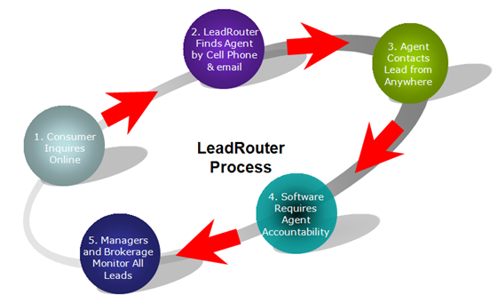
Your Buyers reach me in an instant
We have the technology: LeadRouter℠ is a software application empowering CENTURY 21® sales associates to receive buyer leads for your property from wherever they are, instantaneously.
LeadRouter sends alerts when a potential buyer inquires about your property, enabling me to respond immediately. This means that buyers interested in your property will be able to reach me quickly.

Slide 12
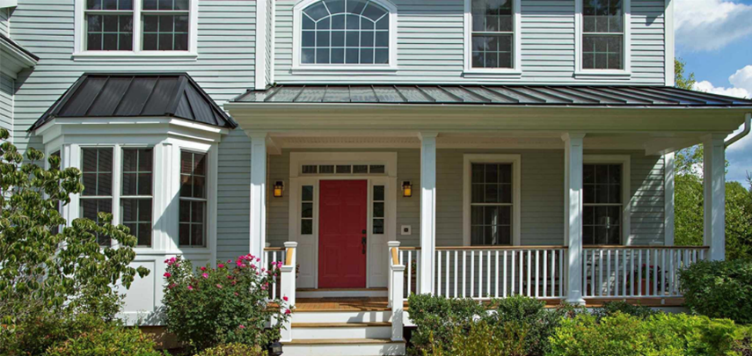
A Unique Property Deserves a Unique Property Site
By creating a Unique Property Site for each of my listings, I am able to attract online buyers as well as provide local buyers with fast and comprehensive information about your property.
These days, it’s easy for properties to get lost among the thousands of real estate listings added to the market each and every day. Your Unique Property Site will ensure that your property stands out from the crowd!

Slide 13
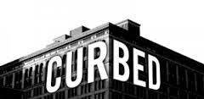
A Powerful Web Presence

Slide 14
FRONT DESK APPOINTMENT CENTER
There are real estate companies that do not handle their own appointment settings. They have an outside vendor set the appointments. We at CENTURY 21 ADVANCE have an in-house appointment staff. We use software to manage appointments to keep track of things. You will get personal attention from our own staff who you will get to know and trust. You can receive requests via phone, email or text, your choice!

Slide 15
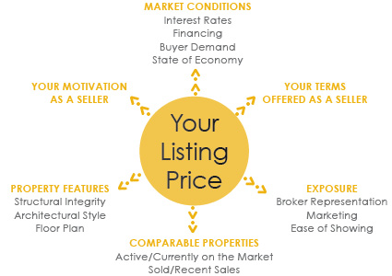
Factors that Influence the Value of your Home
FACTORS THAT HAVE NO IMPACT ON THE CURRENT VALUE OF YOUR HOME:
What you paid for it.
Certain investments made in the property.
What you want to net from the sale.
What those outside the industry believe the property is worth.

Slide 16
Pricing Your Home To Sell
Intelligent Pricing
By pricing your property at market value, you expose it to a much greater percentage of prospective buyers.
This increases your chances for a sale while ensuring a final sale price that properly reflects the market value of your home.
Activity vs. Timing
The Effect of Overpricing
A property attracts the most attention, excitement and interest from the real estate community and potential buyers when it is first listed on the market.
Improper pricing at the time of initial listing misses out on this peak interest period and may result in your property languishing on the market.
Improper pricing may lead to a below market value sale price, or even worse, no sale at all.
Your home has the highest chances for a fruitful sale when it is new on the market and the price is reasonably established

