Slide 1
WHAT DOES IT TAKE TO SELL A PROPERTY?
Financial, legal, marketing, screening, security - selling your home requires experience in multiple skill-sets. Go through the questions below and see if you can check off every single one of them.
Understand your goals, objectives and expectations - it’s all about you!
Understand your home and its valuable features and benefits.
Discuss the benefits of listing your home with a CENTURY 21® professional.
Discuss our local market presence and my professional representation services.
Discuss current market conditions and market data to establish the market value of your home.
Discuss your pricing thoughts and pricing strategies.
Select the listing price for your home.
Assure your confidence in our service.
Unless you could tick off all these questions, the skills and training of a professional sales associate would best assist you in selling your property. Only 1 in 20 sellers who try to sell their property on their own are successful in selling at market price. The other 19 suffer inconvenience, lost time, and frustration in their endeavor without reaching their ultimate goal—selling their property at the best possible price, in the shortest time possible and at the least inconvenience. Now, let us show you why you should choose a CENTURY 21 Sales Professional to make your next move!

Slide 2
HOW I
PROPOSE TO WORK WITH YOU
Listen to your goals and expectations
Understand what makes your home valuable
Share why you should list your home with a CENTURY 21® professional
Highlight how our presence and services can help you
Show a 21-point marketing plan to sell your home
Determine the market value of your property
Discuss optimal pricing strategies
Select the listing price for your home
Share resources and tips to help you get started
Answer any questions you may have

Slide 3
CENTURY 21 REAL ESTATE
AN OVERVIEW
1
81
8,000
+
countries
offices
of the world’s most visited real estate franchise websites
3M
+
47
The most recognized name in real estate*
website visits per month
years of industry-leading experience
And A GLOBAL NETWORK of extraordinary sales associates ready to help
* Study Source: 2017 Ad Tracking Study. The survey results are based on 1,200 online interviews with a national random sample of adults (ages 18+) who are equal decision makers in real estate transactions and active in the real estate market (bought or sold a home within the past two years or, plan to purchase or sell a home within the next two years). Brand awareness question based on a sample of 1,200 respondents. Results are significant at a 90% confidence level, with a margin of error of +/-2.4%. Recognition question based on consumers aware of brand in question. Results are significant at a 90% confidence level, with a margin of error of +/- 2.4%. The study was conducted by Millward Brown, a leading global market research organization, from April 12-26, 2017.

Slide 4


YOUR HOME. OUR WORD.
A CENTURY 21 Home Protection Plan©, issued by American Home Shield®, can help your property stand out and give potential buyers added confidence.
A home warranty adds value to your home by protecting you and your buyer from unexpected costs for covered repairs to plumbing, electrical, heating, air conditioning and more.
A CENTURY 21© HOME PROTECTION PLAN CAN HELP YOU
Mitigate unexpected issues from the home inspection to keep the sale of your home on track
Maintain your budget by managing the high costs of covered repairs on covered systems*
Focus on your next home and upcoming move instead of the property you are trying to sell
ADDITIONAL BENEFITS
Get exclusive discounts on brand-name appliances with the AHS Appliance Discount Program to show your home with the high-end feel of brand-new appliances. Get up to 50% off retail prices on AC/Furnace filters for your home by visiting discountfilterprogram.com
You can ask me to include a CENTURY 21 Home Protection Plan in your real estate transaction. Call 866.797.4802 or visit ahshome.com/c21
Refer to your agreement for complete coverage details.
In Hawaii, air conditioning includes ducted, ductless and window units; heating not included.
*Subject to $2,000 cap during listing period.
C21 Home Protection Plan Logo

Slide 5

WHAT YOU CAN EXPECT FROM US
AS A CENTURY 21® PROFESSIONAL I WILL:
Provide you with professional, personalized service
Monitor details and coordinate marketing activities for the sale of your home
Show your property to qualified buyers
Present all written offers
Facilitate the closing
TO HELP SELL YOUR HOME, WE WILL UTILIZE THE CENTURY 21 SYSTEM WHICH INCLUDES PROPRIETARY MARKETING TOOLS, A GLOBAL NETWORK AND PROVEN SERVICES:
CENTURY 21 Internet Marketing Program:
century21.com
century21espanol.com
Neighborhood profiles
Targeted e-mail communication
Social media presence
Facebook ®
Twitter ®
YouTube ®
Flickr™
Website listing distribution network
National advertising
Local advertising
CENTURY 21 Preferred Client Club®
Direct mail marketing
CENTURY 21 Fine Homes & Estates® digital magazine
Global Referral Network
SELLER SERVICE PLEDGE®
Buyer lead distribution program (LeadRouterSM)
Client lead reporting tool

Slide 6

TRAINED TO BE ON TOP OF THE GAME
Each real estate transaction is a big deal with many moving parts. It can get unwieldy without the right support. CENTURY 21® Sales Associates are a true partner and will support you throughout your real estate transaction. We are:
KNOWLEDGEABLE
With extensive and ongoing formal training to stay on top
ATTENTIVE
Great listeners intent on understanding you and your goals
RESPONSIVE
Quick and professional to respond as we manage each detail and the big picture
The multiple award-winning* CENTURY 21 University® has a proven record of unparalleled agent education by creating industry-leading programs and a comprehensive suite of training and skill development programs.
*Featured in Training Magazines’ Top 125 for 7 of the last 10 years

Slide 7


WE’RE OBSESSED WITH BETTER.
We believe in always maintaining the highest level of customer service.
After each sale, we invite our clients to complete a Quality Service Survey and submit it to an independent research group.

Slide 8

OUR 21 STEP MARKETING PLAN
AN OVERVIEW
Recommend a pre-listing inspection and hiring a professional home staging service
Develop a Comparative Market Analysis (CMA)
Create a photo slideshow or virtual tour to post on listing websites
Enter your listing into the local Multiple Listing Service
Place the CENTURY 21® “For Sale” yard sign
Announce your listing to sales associates in my office and other CENTURY 21 offices in the area
Place a “Lock Box” on your door to provide easy access for other sales associates
Place your listing on our century21.com website
Distribute your listing to hundreds of Listing Partners
Place your listing on social media sites like Facebook ®, Twitter, ® and YouTube ®
Place your listing on my personal website
Create a Unique Property Site for your listing
Prepare full color property flyers and brochures to showcase your home to buyers and other sales associates
Offer the CENTURY 21 Home Protection Plan® that can help attract buyers to your property
Schedule email marketing pieces to my entire list of contacts and past clients as well as area REALTORS®
Print (newspaper) and direct mail advertising in our local area
Just Listed Cards
Open House Cards
Hold an Open House for area REALTORS and the public
Tour your home with prospective buyers
Provide you with constant feedback from buyer showings
Send you weekly online activity reports on your property
Negotiate with potential buyers on your behalf to help get you to the closing table
THE FOLLOWING PAGES ALSO HIGHLIGHT SOME KEY MARKETING COMPONENTS. WORKING TOGETHER, THIS COMPREHENSIVE PLAN IS DESIGNED TO SELL YOUR PROPERTY AS QUICKLY AS POSSIBLE AND FOR THE BEST PRICE.

Slide 9
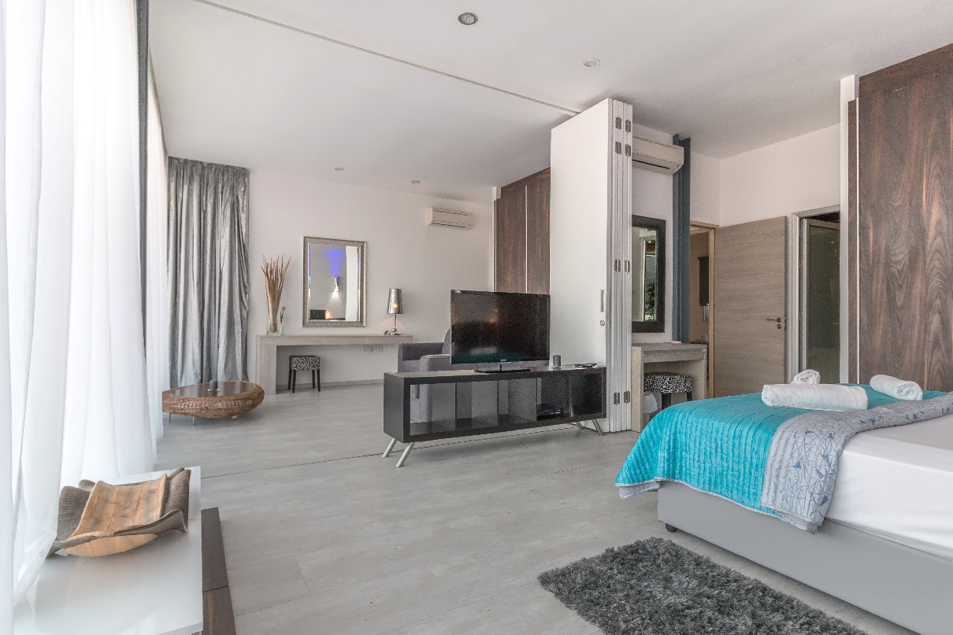
WHAT MAKES YOUR HOME VALUABLE?
STAGING YOUR HOME FOR BUYERS
8 SECONDS is what most buyers take to form a first opinion of your house. Let's make them count! HOME STAGING CAN HELP
Highlight your home’s best features and appeal to the buyer’s senses
Maximize your home’s attractiveness to form an emotional connection
Captivate the buyer with a great first impression that stays in their memory
Ideally, your home should impress and motivate a buyer to swiftly make an offer before it’s gone from the market. Follow simple exterior and interior design ideas and the home-improvement suggestions from our Moving Checklist to get started.

Slide 10
WHERE DO HOME BUYERS BEGIN?
To search for a new home:
95%
USE THE INTERNET* Of which 51% first find the home they buy online*
74%
USE A MOBILE DEVICE OR TABLET* Of which 68% find theirs on a mobile app*
The internet is the FIRST PLACE to be present
And with OVER 3M VISITS PER MONTH, century21.com will get your property noticed
* 2017 National Association of REALTORS® Profile of Home Buyers and Sellers

Slide 11
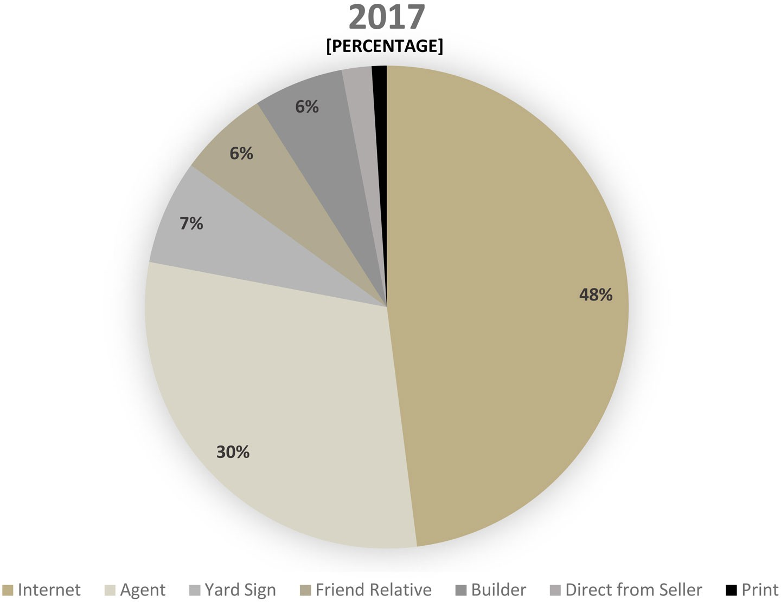
3 OUT OF 4 HOMES
IN 2017 WERE SOLD ONLINE OR THROUGH AGENTS
Where buyers found the homes they actually purchased in 2017
Source: 2017 National Association of REALTORS® Profile of Home Buyers and Sellers

Slide 12
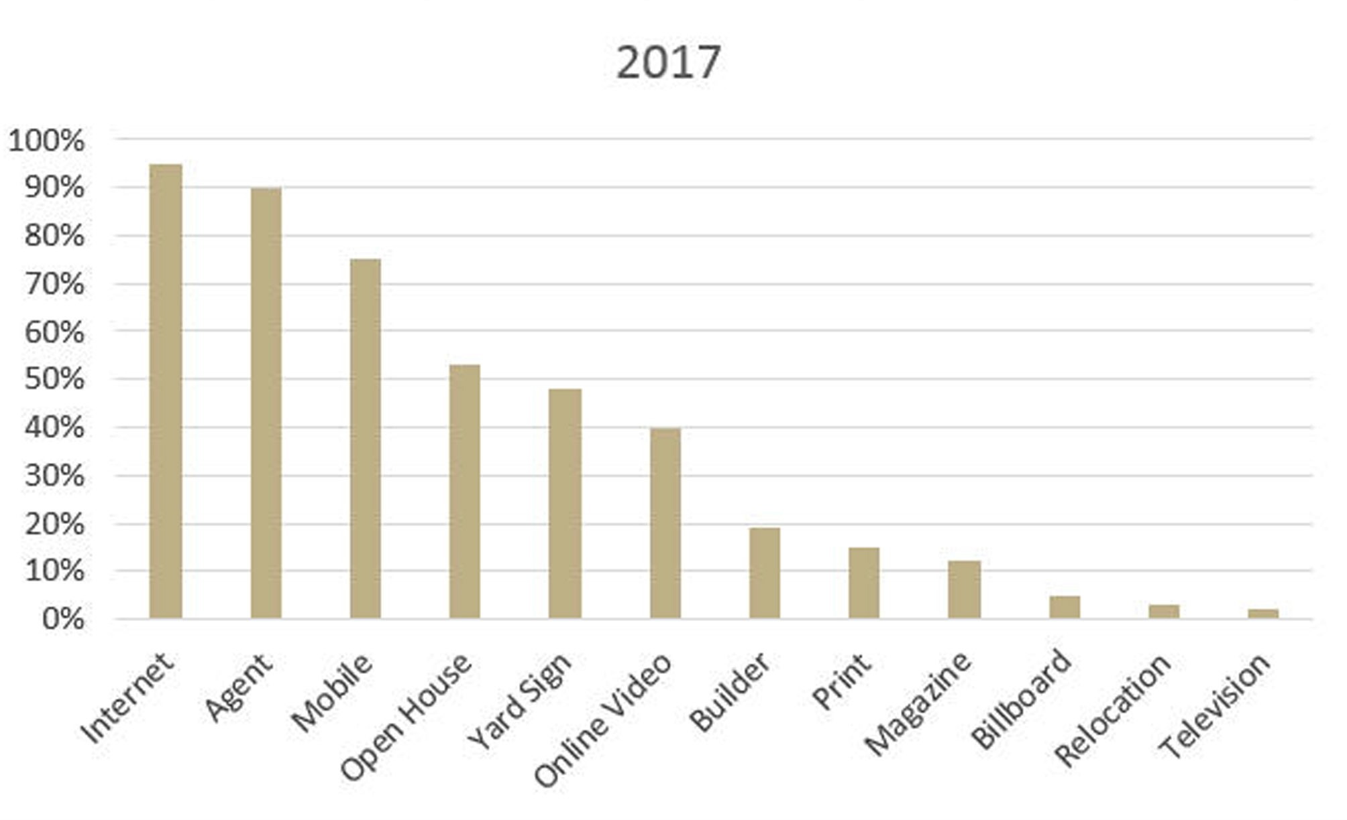
THE HOME SEARCH PROCESS
The search for a new home starts with a search box
Information sources that buyers used during their home search in 2017
Source: 2017 National Association of REALTORS® Profile of Home Buyers and Sellers

Slide 13
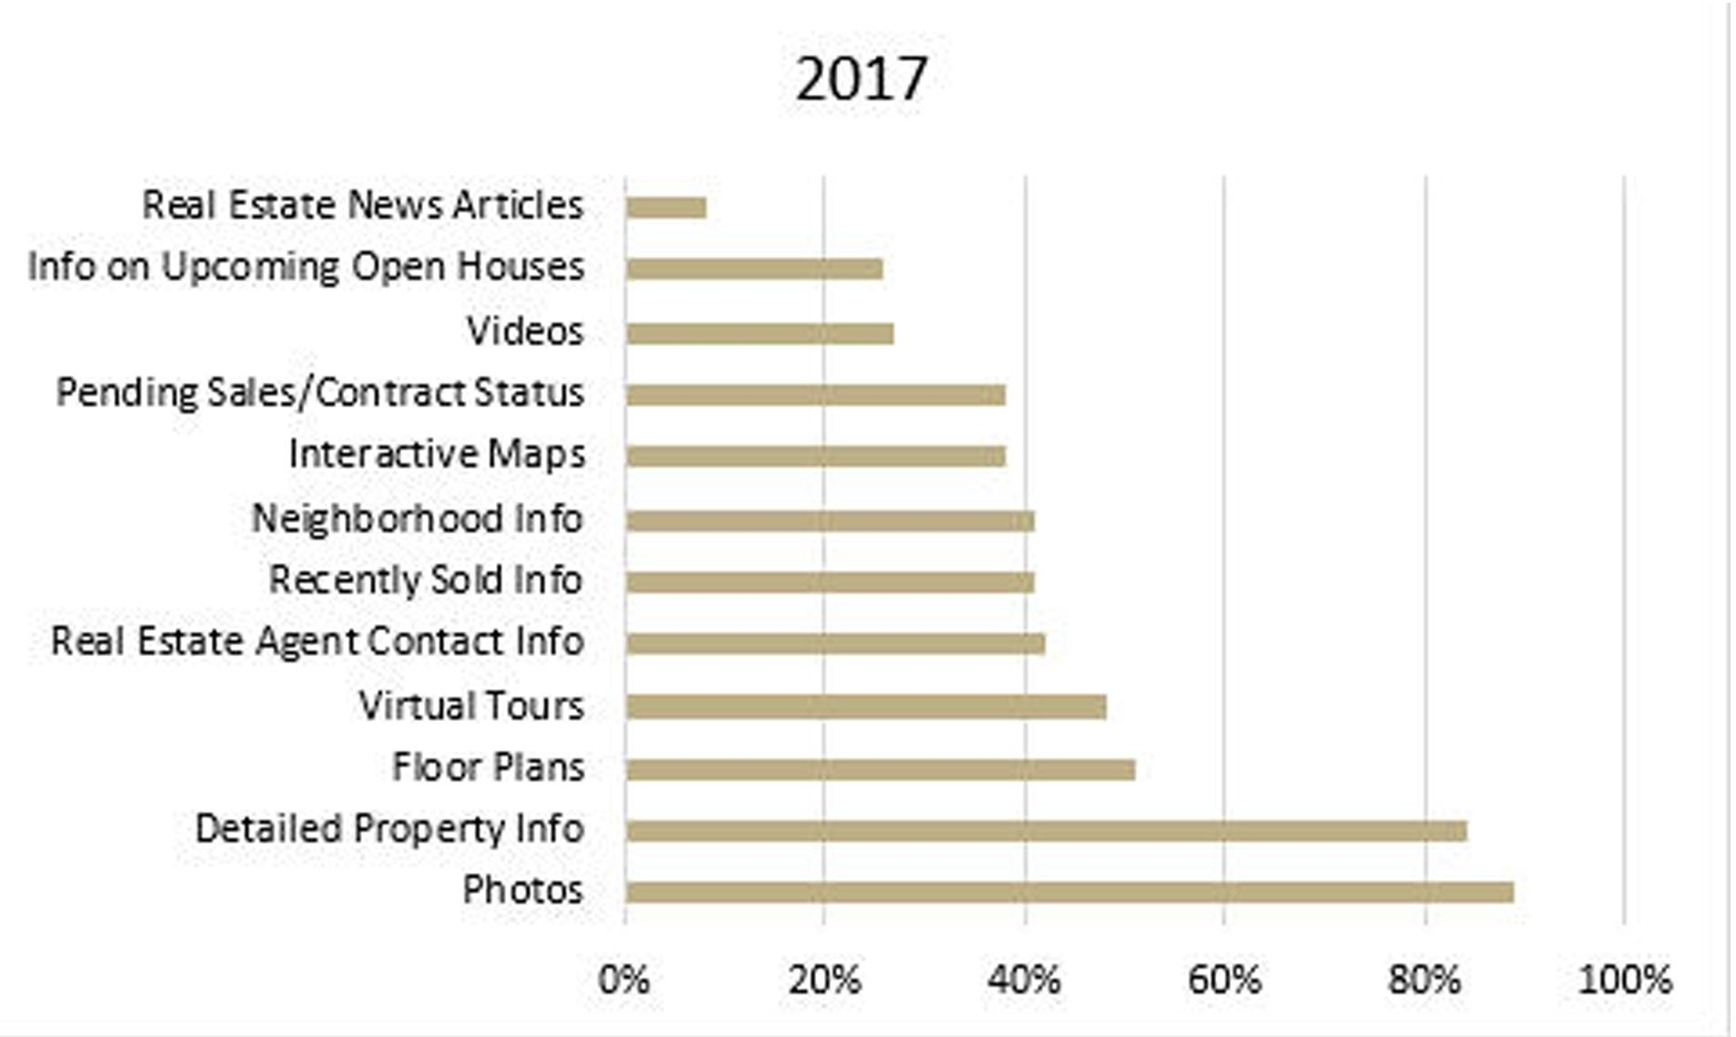
PHOTOS AND DETAILS MATTER MOST ONLINE
What internet home buyers deem “very useful”
Source: 2017 National Association of REALTORS® Profile of Home Buyers and Sellers

Slide 14
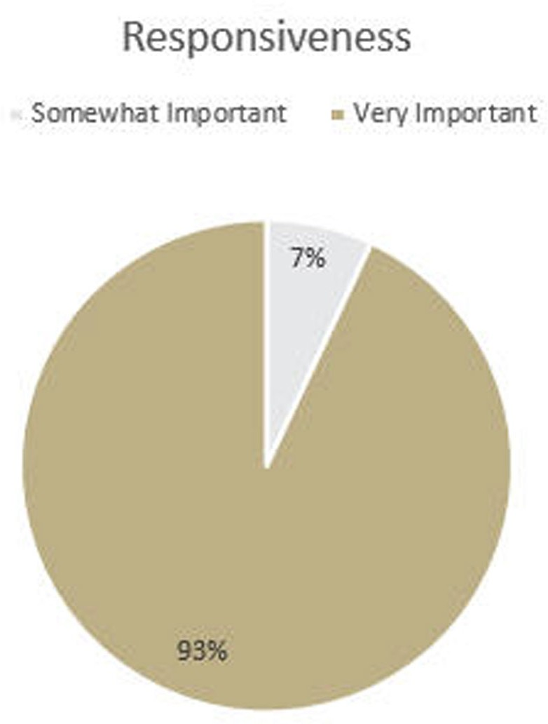
AGENT RESPONSE TIME IS CRITICAL
93% OF BUYERS CONSIDER RESPONSIVENESS “VERY IMPORTANT”
Importance of agents response time – according to buyers
Source: 2017 National Association of REALTORS® Profile of Home Buyers and Sellers

Slide 15
CONNECTED CONSUMERS ARE THE MOST VALUABLE*
They drive their home search using both mobile and desktop tools. THEY ARE:
Likely to have 5 connected devices in their household
6X more likely to request a showing
4X more likely to buy a home
The technology and tools in the CENTURY 21® System enable me to be fast, insightful and personal in communicating with connected customers. So I can provide the level of service they expect to sell your property.
* 2014 ZipRealtyTM Home Buyer Survey

Slide 16







AND FEATURE YOUR HOME WHEREVER BUYERS LOOK
Up to 7 different websites are viewed during search.* We can ensure your property is displayed on them all. Including the internet’s most visited real-estate websites.
and on most MLS-enabled real estate sites.
* 2014 ZipRealtyTM Home Buyer Survey

Slide 17
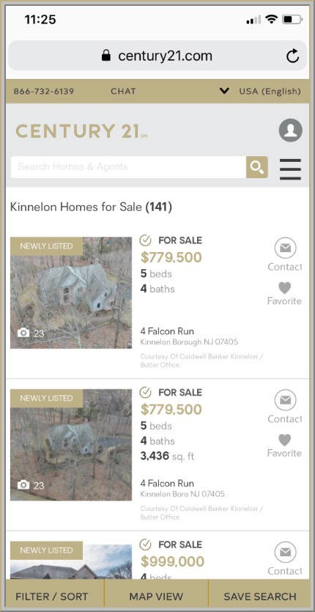
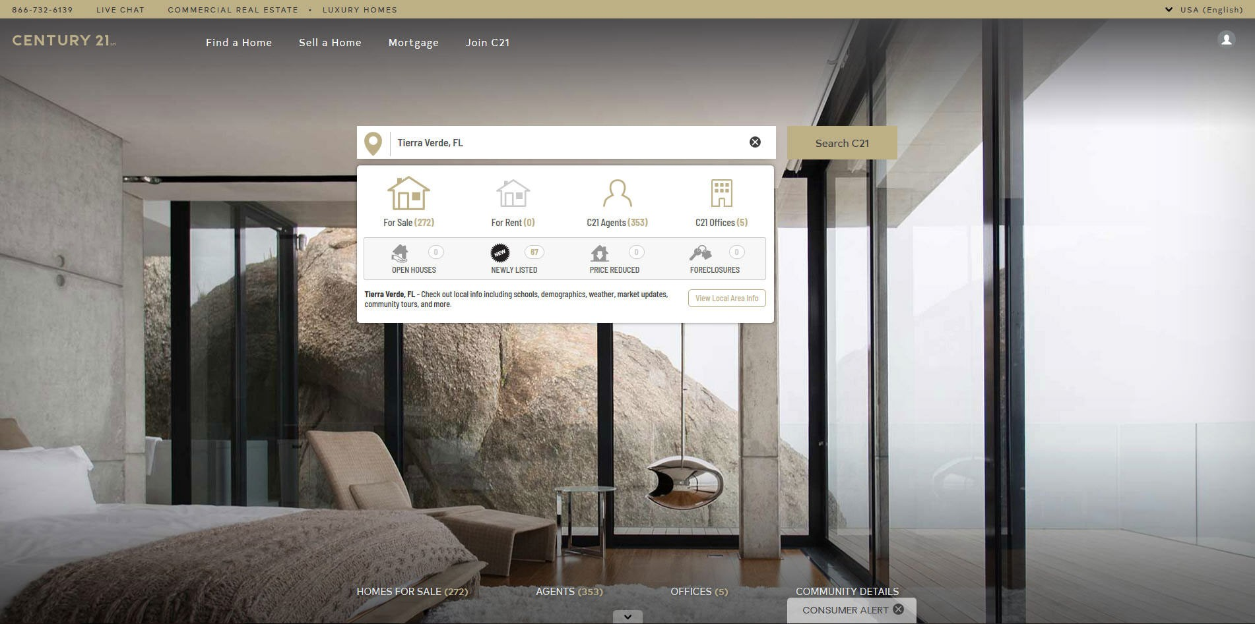
WE’RE ALWAYS RESPONSIVE AND MOBILE. JUST LIKE YOUR LISTING.
Close to 70% of all home buyers in 2017 found their home with a mobile app.* And we have all the tools to make your property look great on the go:
USER-FRIENDLY
79% of consumers leave a non-mobile optimized site. So century21.com displays your home in its responsive interface optimized for mobile devices.
MULTI-PLATFORM
The state-of-the-art CENTURY 21® Zap® suite of digital products attracts and engage online buyers across our website, mobile website and mobile app.
INTERACTIVE
Agents can monitor each prospect's website activity. So I can predict who is “ready” and reach out at the right time, through chats or comments, to elicit a response.
* 2017 National Association of REALTORS® Profile of Home Buyers and Sellers

Slide 18

YOUR HOME IN FULL-SCREEN ON THEIR PHONE
Photos are the #1 thing buyers want to see online.*
And we showcase your home in vivid detail.
BEAUTIFUL
Slide Show design
VIVID
Full Screen mode
ACCESSIBLE
on most mobile devices
* 2016 National Association of REALTORS® Profile of Home Buyers and Sellers

Slide 19




AND SOCIAL MEDIA TO FIND THE RIGHT BUYER
Millions of people use social media channels like Facebook ®, Twitter ®, FlickrTM and Instagram ® daily.
The CENTURY 21® System, the cutting edge of real-estate marketing, successfully uses social media to promote your property listing and locate the right buyer for it.
* 2016 National Association of REALTORS® Profile of Home Buyers and Sellers

Slide 20
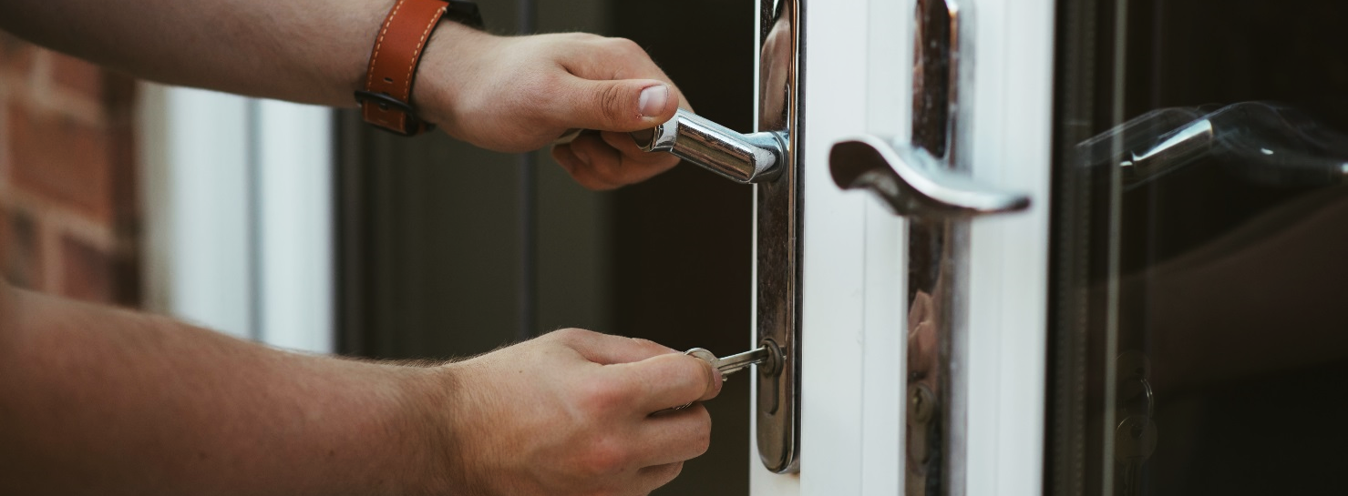
RELOCATE ALMOST ANYWHERE IN THE WORLD
With our Relocation Services, we can find you a great CENTURY 21® office anywhere you go.
WHETHER YOU ARE MOVING ACROSS THE STATE, THE COUNTRY OR THE WORLD, WE CAN HELP:
Connect you with an experienced CENTURY 21 Sales Associate, trained in relocation services, to represent you
Send you a customized relocation packet designed to meet your specific needs, including community and school information
Provide cost of living analysis
Offer a city-to-city comparison of your current location to your new location
Help you get to know the community you are moving to
Give a detailed market analysis of your current home
Coordinate the sale of your current home and the purchase of your new home
Work with mortgage services for information, including obtaining loan pre-approval for your new home
Partner with your Corporate Relocation Program, if any

Slide 21
WE CAN RESPOND TO BUYERS IN REAL-TIME
With the LeadRouter™ System software app, I can receive buyer leads and inquiries regarding your property instantly. This enables me to immediately respond to prospects from any location.
The LeadRouter response process:
1
5
A prospect inquires online
2
Managers and brokerage monitor all leads
LeadRouter notifies agent by cellphone and email
4
3
Software requires agent accountability
Agent immediately contacts lead from anywhere

Slide 22
11 THINGS YOU NEED TO LIST YOUR PROPERTY
1. Last year's tax bill
2. Survey
3. Account numbers for mortgage
4. 3 copies of the key to the front or main entrance door
5. Invoices for repairs or improvements to the property
6. A list of inclusions and exclusions in the sale
7. Any interior or exterior pictures of the property
8. Declarations/covenants/deed restrictions (if applicable)
9. Utility bills, actual monthly costs or monthly budget
10. Information on special assessments (if applicable)
11. Homeowners/Condominium association information (if applicable)
Amount
Company
Address
Contact name
Phone number

Slide 23
SELLER SERVICE PLEDGE® CERTIFICATE
As an independently owned and operated CENTURY 21® office, we are dedicated to providing you with service that is professional, courteous and responsive in helping you market your property. To fulfill this commitment, we agree to provide you with the following services:
Dedicate ourselves to making the process of selling your home as easy and successful as possible.
Respect you and your needs and be honest and forthright, in accordance with Fair Housing regulations and ethical real estate practices.
Hold your best interests in the highest regard throughout the process.
Value and respect your time, being as efficient and effective as possible.
Endeavor to always understand your needs and respond quickly.
Provide regular progress reports throughout the process, and discuss comments received about your property with you.
Explain each step of the process and act as a guide to help you make informed decisions.
Make recommendations to enhance the marketability of your property.
Utilize a written Competitive Market Analysis and local market information to help you set an appropriate listing price to sell your home and receive the value you deserve.
Introduce you to other professionals (mortgage lenders, title agents, etc.) for information or assistance as appropriate.
Develop , present and agree upon a Customized Marketing Plan that will detail specific promotional efforts to help best market your property.
Place the internationally recognized CENTURY 21 yard sign on your property, with your permission and subject to local ordinances.
Post your property on c21.com, a site which receives millions of visitors each month.
Promote your property to potential buyers.
Utilize the CENTURY 21 System's vast online resources to expose your property to potential buyers around the world.
Utilize the CENTURY 21 System to help you obtain the results you deserve, including leveraging our network of more than 8,300 offices worldwide.
Submit to you all written offers, assist with negotiations, and provide an estimate of your net sales proceeds, so you understand these implications prior to the acceptance or rejection of any offer.
Upon acceptance of an offer by you, pre-settlement (escrow) activities throughout the closing process will be monitored as permitted by law or local practice.
Assist you in finding your next home, or offer to refer you to another CENTURY 21 Office in another location.
Use the full breadth of our collective experience, knowledge , tools &the most up-to-date training to best serve you.
21.
We appreciate you allowiing us to help you with the marketing of your property. If at any time you have a question, concern, comment or suggestion, please contact:
Name: Phone:
This CENTURY 21 ® SELLER SERVICE PLEDGE ® Certificate applies only to an exclusive right to sell agreement of not less than days. Please be advised that the nature of the agency relationship as contemplated by this SELLER SERVICE PLEDGE may change in the course of a transaction with your permission or by operation of state law. In this event, some of the services represented may change or become void. If any terms or conditions contained herein are prohibited by local law, they shall be considered severed from this pledge and of no force or effect. In the event of any alleged breach under the terms of this 21 Point SELLER SERVICE PLEDGE Certificate , the seller (as a sole and exclusive remedy) may terminate the exclusive right to sell agreement, provided that the local independently owned CENTURY 21 office is given ten days (10) written notice of the reason for termination and an opportunity to cure the default during the notice period.
A Copy of this SELLER SERVICE PLEDGE Certificate has been received on (date): _ From CENTURY 21 By Seller(s):
Associate: Current Address:
License #: Current Phone:
Broker(s): Email:
© 2018 Century 21 Real Estate LLC. All Rights Reserved. CENTURY 21® and the CENTURY 21 Logo are registered service marks owned by Century 21 Real Estate LLC. Century 21 Real Estate LLC fully supports the principles of the Fair Housing Act and the Equal Opportunity Act. Each office is independently owned and operated.

Slide 24


LET’S SELL BETTER AND FASTER
RESOURCES AND TIPS FOR YOU TO GET STARTED

Slide 25
I COMMIT TO DELIVERING AN EXTRAORDINARY SALES EXPERIENCE TO YOU
When you choose me to list your home, you will receive:
Excellent service and support
A market analysis of your home
A winning marketing plan
Every effort to sell your home promptly
The resources of Century 21 Real Estate

Slide 26
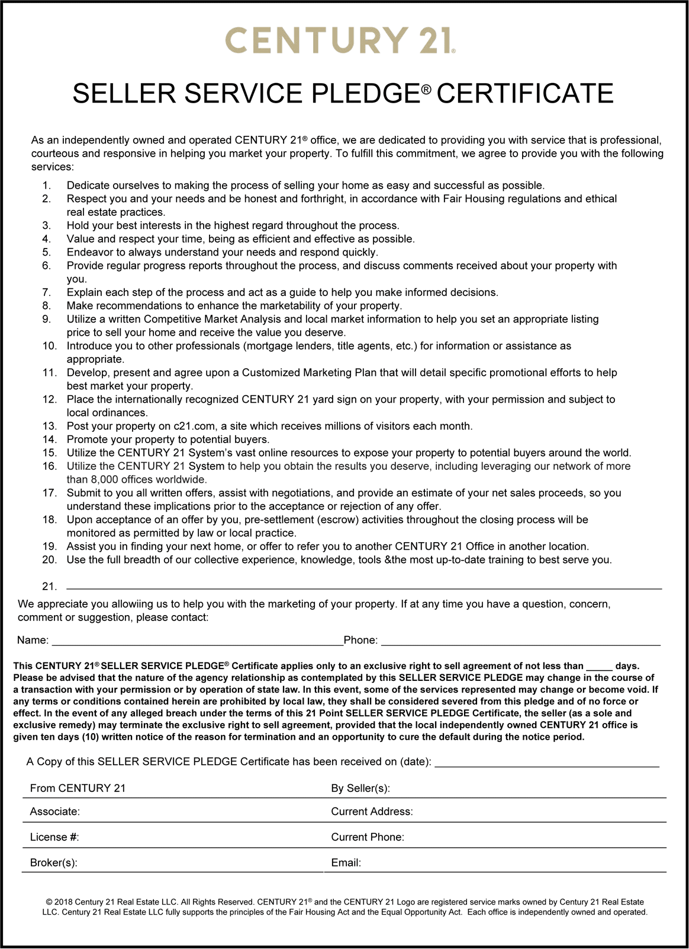
OUR COMMITMENT TO YOU
This CENTURY 21® SELLER SERVICES PLEDGE® Certificate applies only to an exclusive right to sell agreement of not less than days. If any terms or conditions contained herein are prohibited by local law, they shall be considered severed from this pledge and of no force or effect. In the event of any alleged breach under the terms of this 21 Point SELLER SERVICE PLEDGE Certificate, the seller (as a sole and exclusive remedy) may terminate the exclusive right to sell agreement, provided that our CENTURY 21 Office is given ten days (10) written notice of the reason for termination and an opportunity to cure the default during the notice period.

